Slide 1
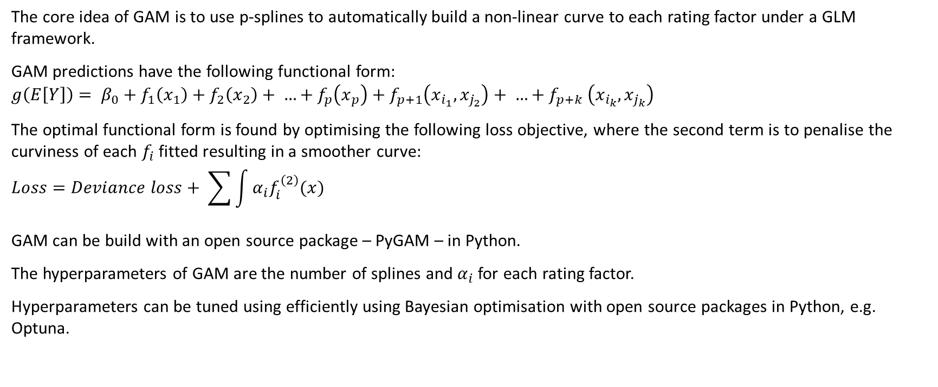
GAM Overview
The core idea of GAM is to use p-splines to automatically build a non-linear curve to each rating factor under a GLM framework.
GAM predictions have the following functional form:
$$g\left(E\left[Y\right]\right)= β_{0}+f_{1}\left(x_{1}\right)+f_{2}\left(x_{2}\right)+ …+f_{p}\left(x_{p}\right)+f_{p+1}\left(x_{i_{1}}, x_{j_{2}}\right)+ …{+ f}_{p+k}\left(x_{i_{k}}, x_{j_{k}}\right)$$
The optimal functional form is found by optimising the following loss objective, where the second term is to penalise the curviness of each $f_{i}$ fitted resulting in a smoother curve:
$$Loss=Deviance loss+ \sum{\int{α_{i}f_{i}^{\left(2\right)}(x)}}$$
GAM can be build with an open source package – PyGAM – in Python.
The hyperparameters of GAM are the number of splines and $α_{i}$ for each rating factor.
Hyperparameters can be tuned using efficiently using Bayesian optimisation with open source packages in Python, e.g. Optuna.

Slide 2
GAM Development Procedure
1
Perform feature engineering on the raw data, e.g. one-hot encoding categorical variables.
2
Build a single-factor model with all the features.
3
Perform iterative factor pruning to get the optimal set of features.
4
Build a final single-factor model with the optimal features.
5
Build a depth-two GBM with the single factor model predictions as starting points to detect any significant interaction effects.
6
Build a final GAM with the optimal features and significant interaction terms detected by the GBM.
7
Evaluate model performance on the holdout and explain the model with partial dependency plots.

